Slide 1
Axon Healthcare
Group-6

Slide 2
Group Details
Kaviraja
Muhammed Shuaib
Manish Kumar
Sujit Bharat Nale
Saurabh Mandlekar
Ramjee Prasad

Slide 3
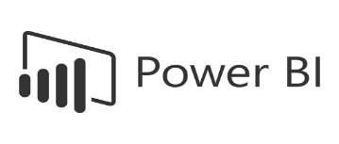



Project Summary
Objective: To analyze hospital performance using EMR data in order to evaluate changes in patient service levels for pre- and post-treatment.
Data Used: It’s collected from the hospitals located in 6 cities; Chicago, Houston, Miami, New York, Los Angeles. The dataset is based on almost three years period, starting from 2023 to 2025.
Tools Used:
Key Features of the Dashboard:
Interactive filters (e.g., by Region, Date, Category)
KPIs displayed: Doctor Workload , Follow-Up Rate , Average Age of Patients etc.
Visuals used: Bar chart, line graph, map, pie etc.
Outcome: To help administration identify the current trends and identify the gaps to improve patient care/requirements accordingly.

Slide 4
KPI List - Key performance indicators and their business relevance
Total Patients - Measures the total reach of healthcare services and helps identify growth trends in patient base.
Total Doctors - Helps assess staffing levels and capacity for patient care
Total Visits - Indicates operational volume, high visit counts may imply strong demand or overutilization.
Average Age of Patients - Helps understand the demographic profile and tailor services
Top 5 Diagnosed Conditions - Identifies prevalent health issues to prioritize resources and care strategies.
Follow-Up Rate - Indicates care continuity and post-treatment monitoring efficiency
Treatment Cost Per Visit (Avg.) - Tracks cost efficiency and helps in budget planning and pricing strategy
Total Lab Tests Conducted - Measures diagnostic activity and helps track lab utilization and resource needs
Percentage of Abnormal Lab Results - Tracks health trends and alerts clinicians to potential public health risks
Doctor Workload (Avg Patients Per Doctor) - Measures efficiency and workload balance; helps in resource allocation and burnout prevention
Total Revenue - Core financial KPI indicating income from services; useful for profitability analysis

Slide 5
What we did in Excel
Data Collection & Preparation
Data Analysis & Visualization
Data was collected from various sources including patient records and billing systems.
Initial cleaning involved removing duplicates, handling missing data, and standardizing formats in Excel.
Pivot tables and formulas helped summarize and explore the raw data.
Analyzed key metrics such as diagnosis distribution and patient age groups.
Created charts to visualize the most common illnesses and patient demographics.
Identified preliminary patterns to guide further analysis.

Slide 6
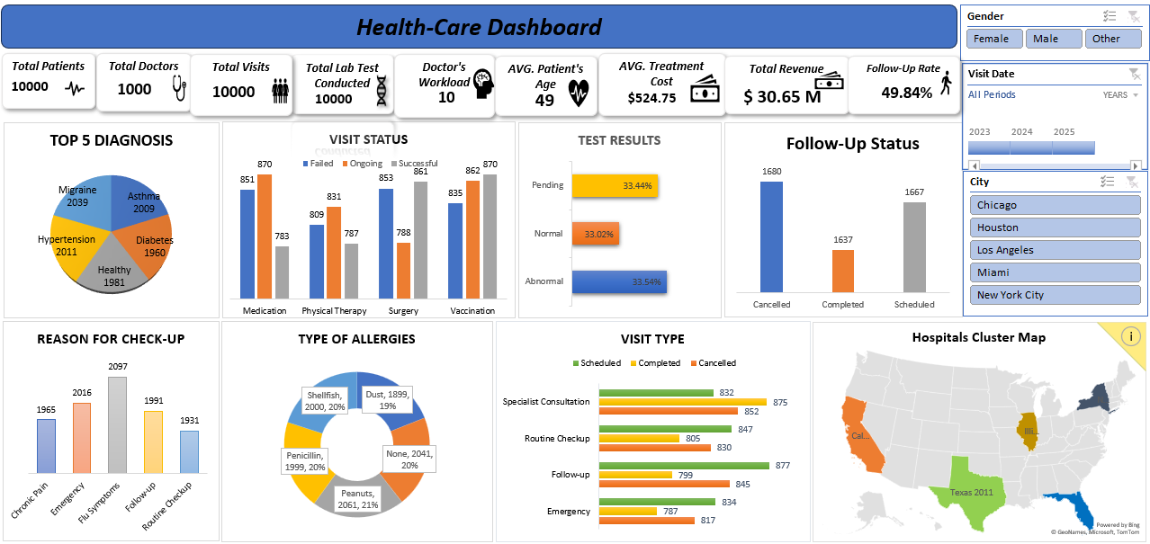
Excel Dashboard

Slide 7
Data Visualization & Insights (Tableau)
Connected data sources to Tableau for detailed visual analysis.
Built dashboards showing hospital clusters, regional patient distribution, and test result trends.
Combined data from main sources in real time for comprehensive analysis.
Calculated Fields has been Created to custom metrics and KPIs without needing extensive coding.

Slide 8
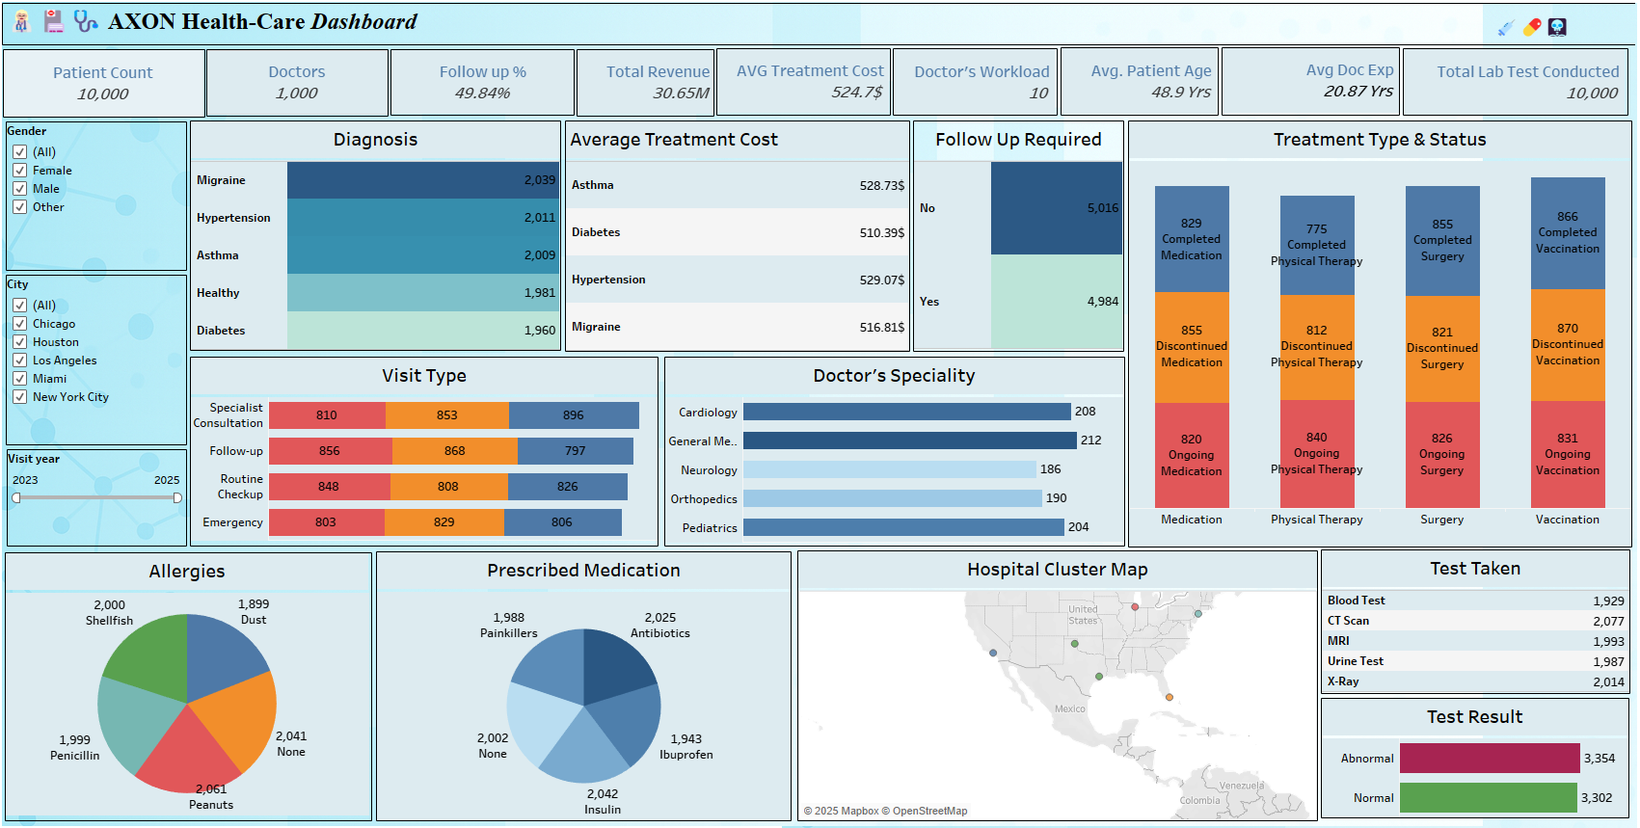
Tableau Dashboard

Slide 9
Data Retrieval & Management (SQL)
Used SQL queries to efficiently extract and analyze large datasets.
SQL streamlined data management and enabled complex analyses.
Data Validation to ensures data integrity by enforcing constraints and validation rules directly in the database.
Data Filtering in SQL to allows precise filtering of data, enabling targeted queries for specific patient groups or time frames.
Joins & Relationships to combines data from multiple tables using JOIN operations (INNER, LEFT, RIGHT, FULL).
Aggregations & Grouping to perform aggregations such as SUM, AVG, COUNT with GROUP BY clauses to summarize the datasets.

Slide 10
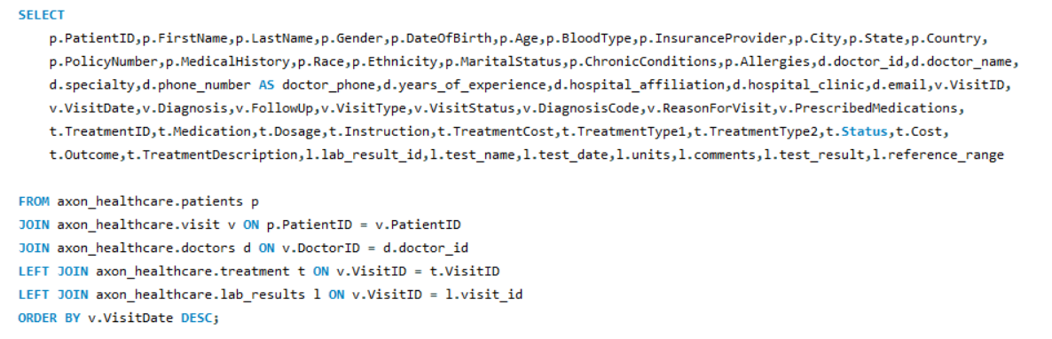
SQL Query Image

Slide 11
Advanced Visualization (Power BI)
Imported cleaned data into Power BI for interactive dashboards.
Dashboards included filters for age, department, and time periods, providing dynamic insights.
Monitored metrics like top diagnoses, average treatment costs, and patient flow trends.
Used Data Analysis Expressions (DAX) to create complex calculated columns and measures for advanced analytics.
Enabled drill-downs for deeper insights into specific departments or regions.

Slide 12
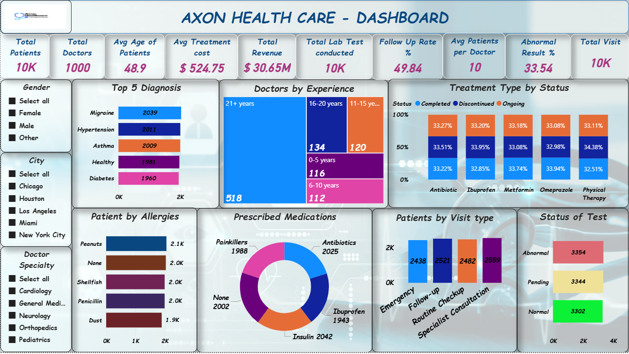
Power BI Dashboard

Slide 13
Key Takeaways
Business Insights
Patient Overview: 10,000 patients served with a balanced gender distribution with average age of patients is 49 years.
Operational Performance:
Average treatment cost: $524.75 & total revenue: $30.65M.
Each doctor handles 10 patients on average.
Health Trends:
Top Diagnoses: Migraine, Hypertension, Asthma, Diabetes, and Healthy check-ups dominate visits.
Common Allergies: Peanuts (21%), Shellfish, Penicillin, Dust.
Frequent Visit Reasons: Flu symptoms, chronic pain, and follow-ups.
Treatment Outcomes: Success rate high across surgery, vaccination, and medication, with approximately 50% follow-up rate.
Lab Results: 33.54% abnormal results indicate a significant patient monitoring requirement.
2. Challenges
High Abnormal Test Rate: One-third of lab results are abnormal, suggesting the need for preventive measures and early screening.
Follow-Up Gaps: Nearly 50% of patients do not return for follow-up care.
Doctor Workload Concentration: Some specializations (e.g., General Medicine, Cardiology) face higher patient loads.
Geographical Coverage: Patient concentration in specific states limits outreach to other high-demand regions.
Treatment Discontinuation: Significant proportion of patients discontinue treatment midway, particularly in physical therapy.

Slide 14
Key Takeaways
3. Future Recommendations
Enhance Preventive Healthcare: Launch awareness programs for early detection and lifestyle management, especially for hypertension and diabetes.
Improve Follow-Up Compliance: Implement automated reminders, teleconsultation options, and follow-up discounts.
Balance Workload: Hire or reallocate specialists to high-demand departments to reduce burnout and improve service quality.
Expand Geographic Reach: Target underserved regions through outreach clinics, partnerships, and marketing campaigns.
Data-Driven Care: Use predictive analytics to identify at risk patients and proactively offer interventions.
Treatment Adherence Programs: Educate and engage patients on completing prescribed therapies to improve outcomes.

Slide 15
Thank You😊
By Group 6

